Slide 1
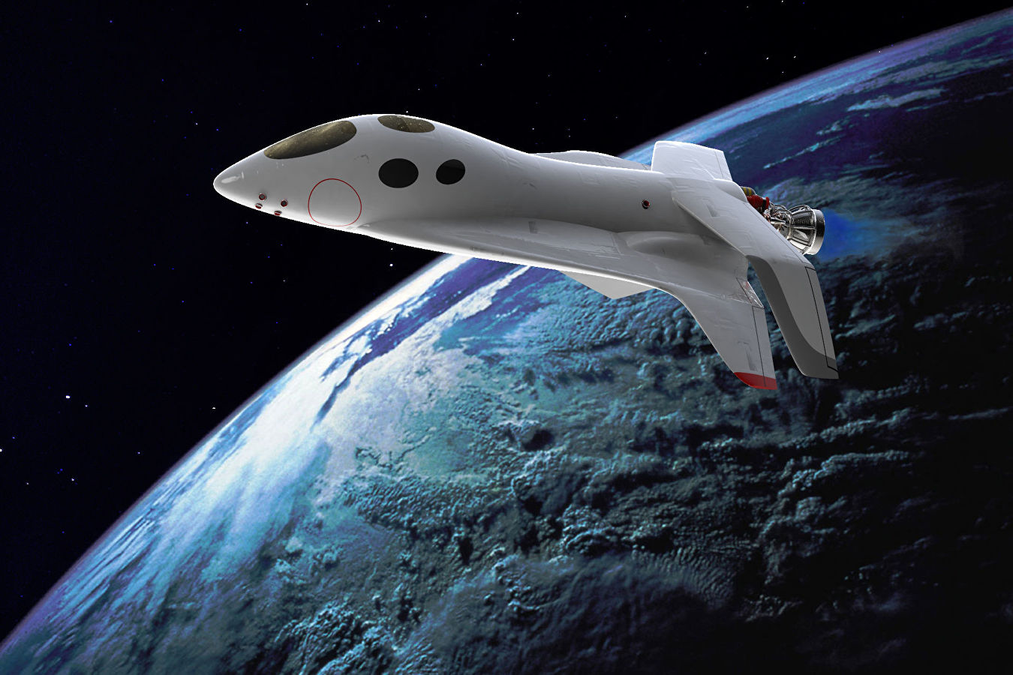
Monster Rampage
By Artem Kokorev

Slide 2
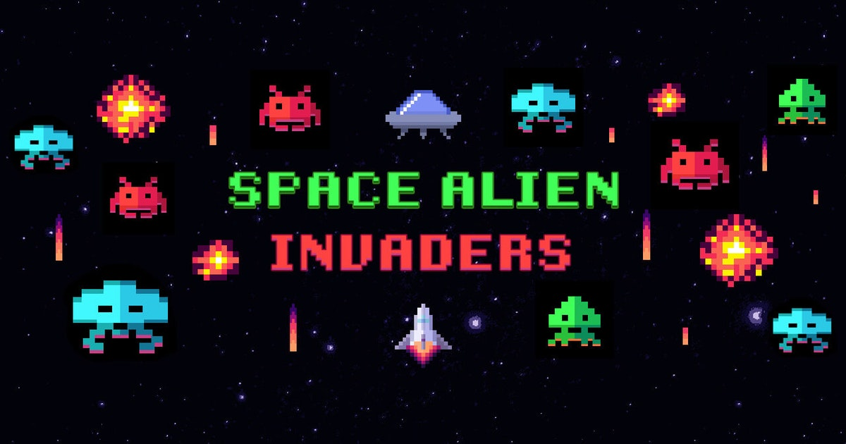
Introduction
To be fair, after learning pygame , I remembered about ball blast game, then I realized that it will be too simple and I have to add movement to for my cannon. It prompted me the idea of clone of space invaders . So I did it as similar as I could.

Slide 3
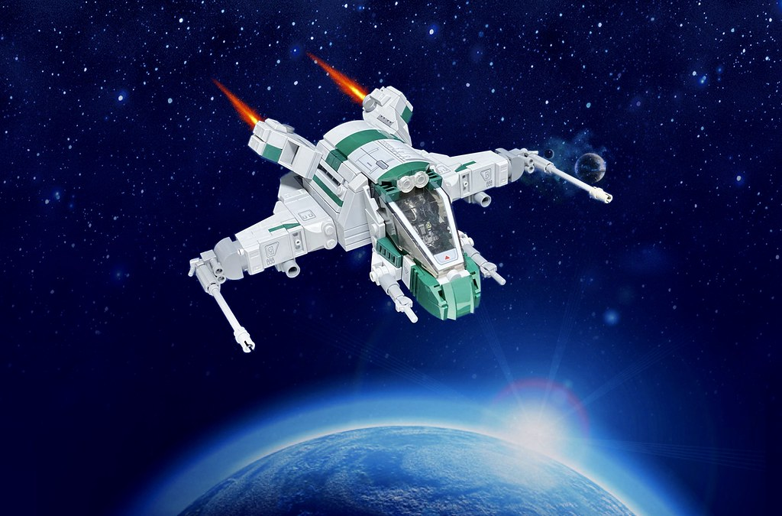
A bit about realization
By and large, I used pygame and most simple libraries like sys and random , because I didn’t want to make this product very loaded and crowded with a lot of strange libraries

Slide 4
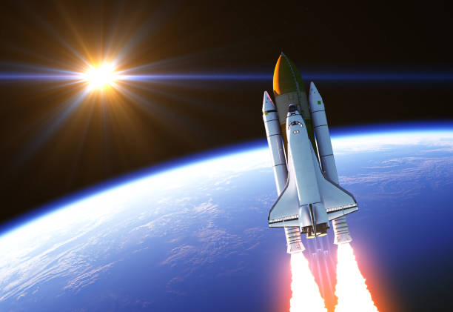
Finally
My game looks like a finished project,
But I think that I can add smth like that:
In-game busters
Some additional customization
Of course more levels
And etc.

Slide 5
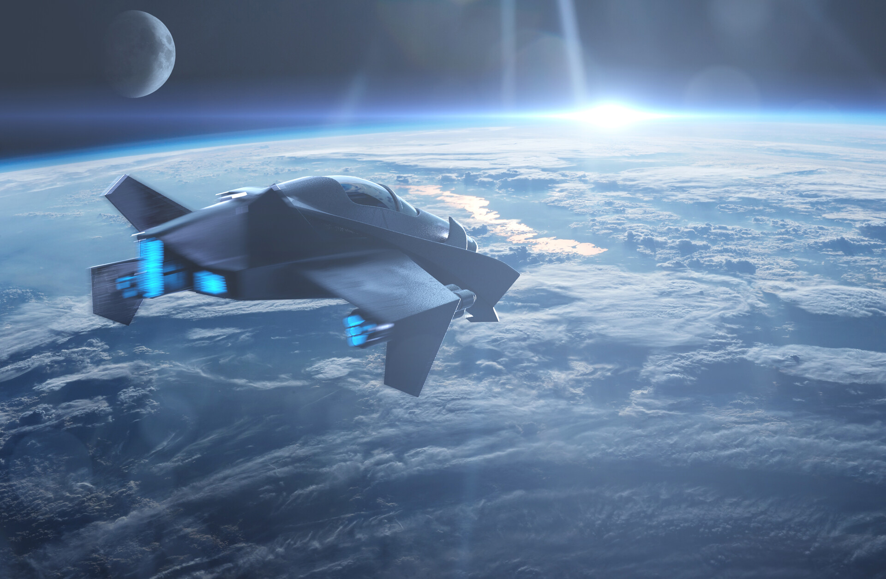
Thanks for your attention !

